Slide 1

Sentiment Analysis for Tesla Stock using Stocktwits
Sachin Singhal | Anisha Desai

Slide 2


Our team
Sachin Singhal
Anisha Desai

Slide 3
Table of Contents
1. Project Background
4. Testing Model
2. Web Scraping
5. Traditional prediction models
6. Learnings & Future Recommendations
3. Training model approaches

Slide 4
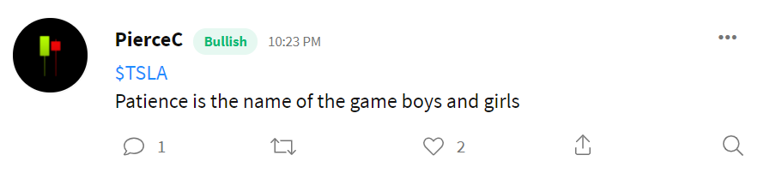

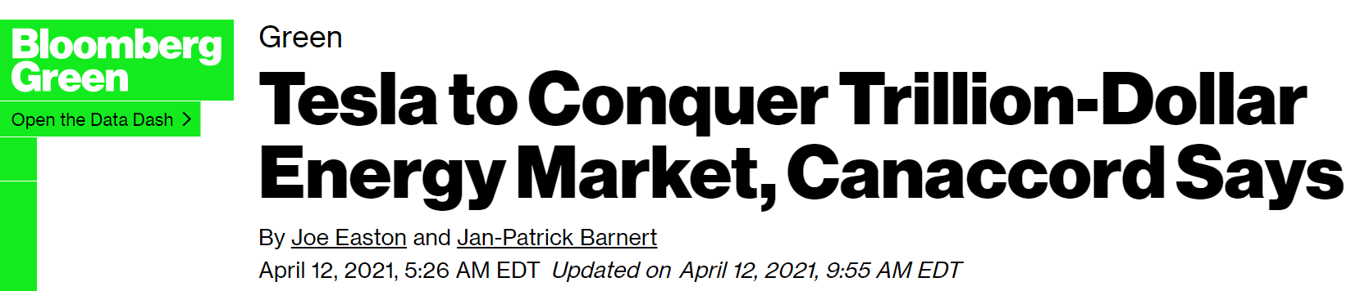
stocktwits
StockTwits – “the largest social network for investors and traders”
The writer of the twit can label the twit as either Bearish/Bullish or leave it blank
TSLA Stock
$TSLA stock highly volatile with respect to tweets.

Slide 5

Web scrapping from stocktwits
Stocktwits offers a free API to access trending stocks on its site. This list of trending stock tickers can be iterated over to scrape any number of useful sentiment indicators.
The parameters used:
Ticker: TSLA Number of iterations: 20000 used
Base ID: since tweet_id
Tweets extracted and used for analysis
Period: 4th Mar’21 to 27th Jun’21
Time frame: 9am to 4pm
Days: Mon - Fri

Slide 6
Extracted data - columns
01
02
03
04
Id
Created_At
Each tweet has a specific ID on which we are iterating while scrapping.
Date of Tweet + Time
Body
sentiment
Text of the tweet
Whether the creater of the tweet has labelled the twit as Bearish/Bullish

Slide 7
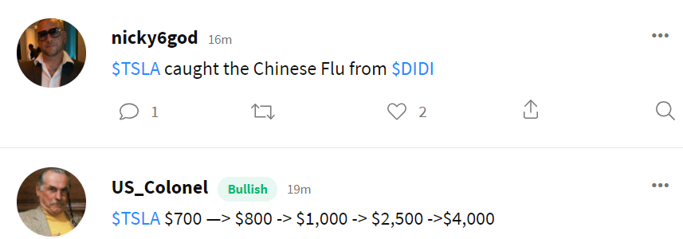
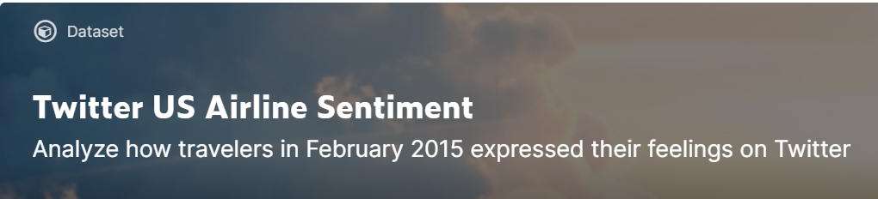
training model approaches
Stocktwits labelled data
Virgin AMERICA data
Using only the labelled data from the extracted stocktwits
Pre-labelled positive & negative sentiment dataset from kaggle
https://www.kaggle.com/crowdflower/twitter-airline-sentiment

Slide 8
Training datasets comparison
% of positive sentiments
Total tweets
 | Labelled Stocktwits | VA data
Total Tweets | 123,830 | 11,341
Sentiment | Bullish : 1 Bearish : 0 | Positive : 1 Negative : 0
70%
20%
Labelled stocktwits
Va data
Positively skewed
Negatively skewed

Slide 9
Data Precossing for datasets
Label conversion
Removing punctuations
Removing STOPwords
tokenization
Labelling the sentiments as 1 or 0
Converting the body of the tweet to lower case & removing punctuation marks
Creating a list of certain stopwords and removing them from the tweet body
Using NLTK package, allotting tokens and assigning a number to each word

Slide 10
Model Comparison
Rnn
lstm
Stacked
Bidirectional
Accuracy
Labelled stocktwits: 79.46%
VA data: 90.97%
Accuracy
Labelled stocktwits: 82.70%
VA data: 91.19%
Accuracy
Labelled stocktwits: 80.90%
VA data: 91.54%
Accuracy
Labelled stocktwits: 82.23%
VA data: 91.89%
Parameters
Optimizer = RMSprop
Learning rate = 0.001
Loss = ‘binary_cross entropy’
Activation function = sigmoid
Max_features =20000
Max_len = 50
Batch_size = 128
Epochs =32
Vocab_size = 20000
Train/test split = 80/20

Slide 11
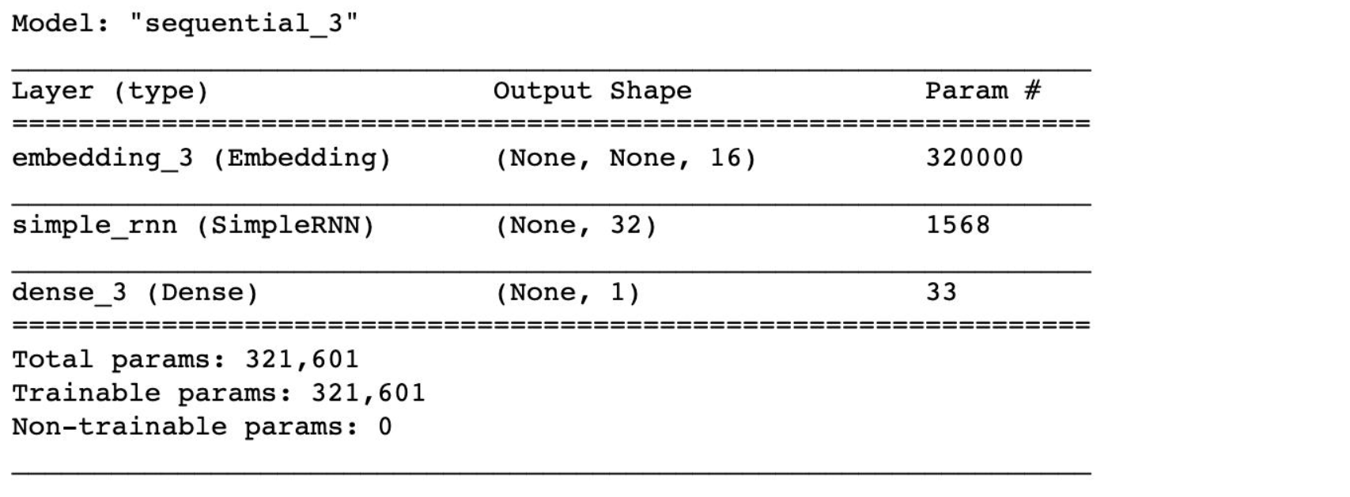
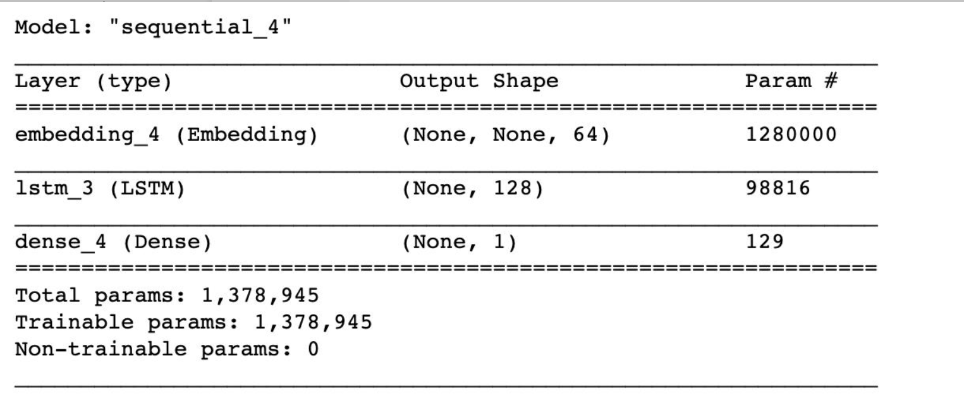
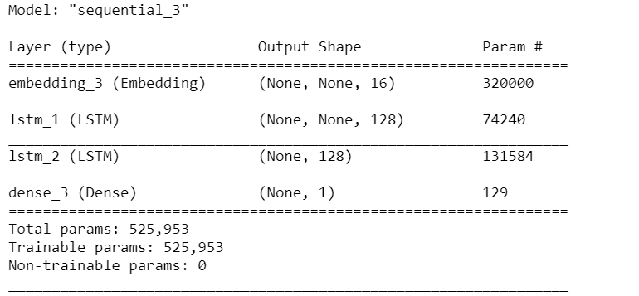
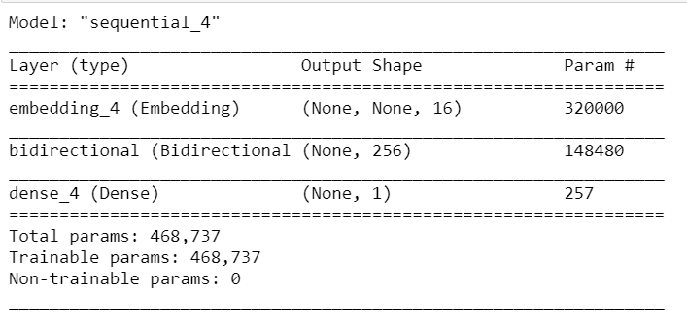
Model Architecture
Rnn
LSTM
Stacked Lstm
Bidirectional Lstm

Slide 12
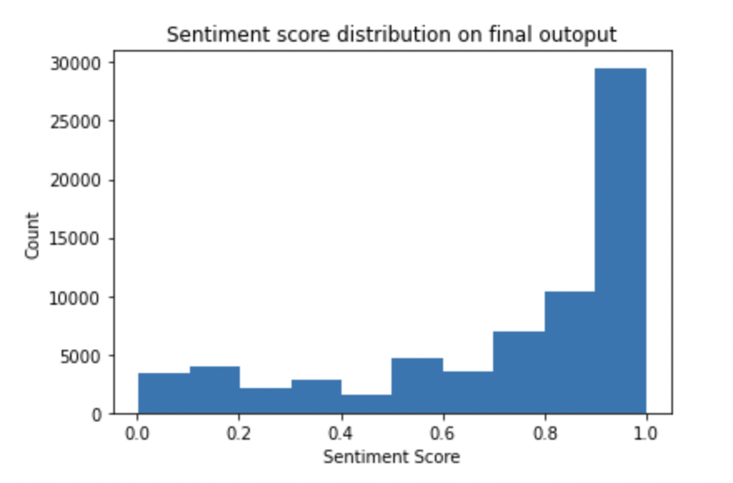
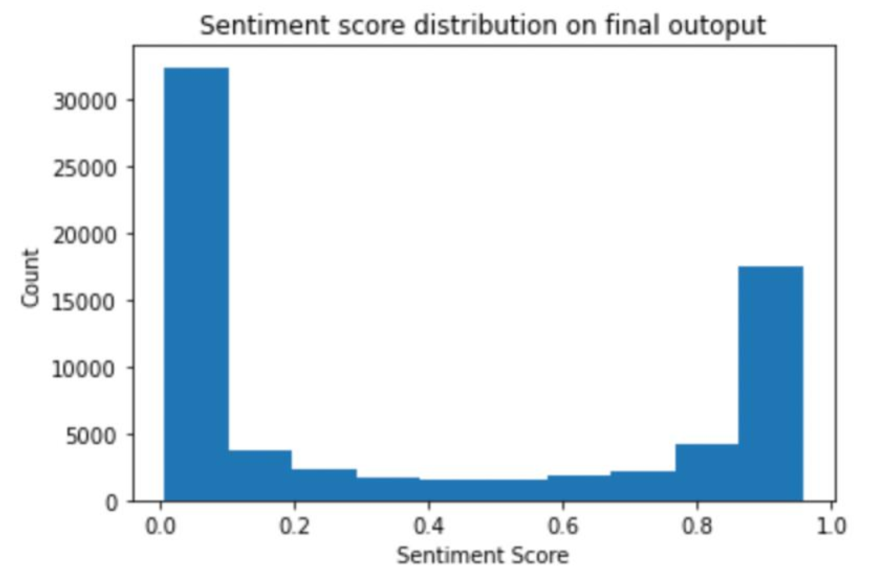
sentiment score predictions
Stocktwits labelled data
Virgin america data

Slide 13
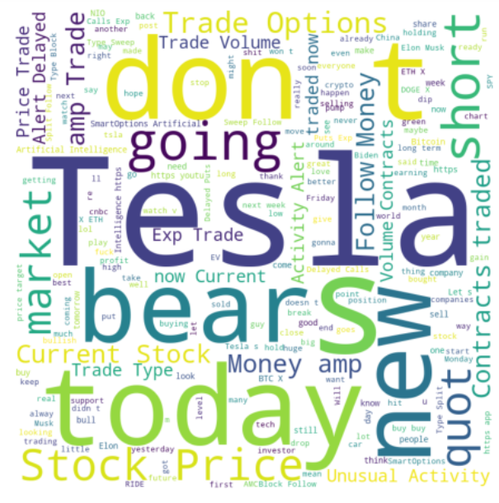
Testing dataset
Total Tweets
65,007
Actual Sentiments
were extracted from Yahoo finance
IF (Closing Price – Opening Price) > 0,
then 1 else 0

Slide 14
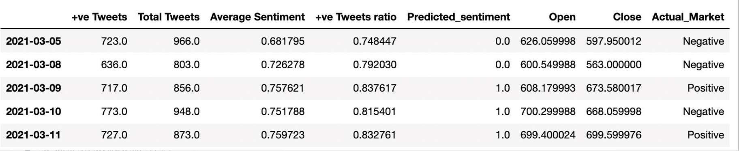
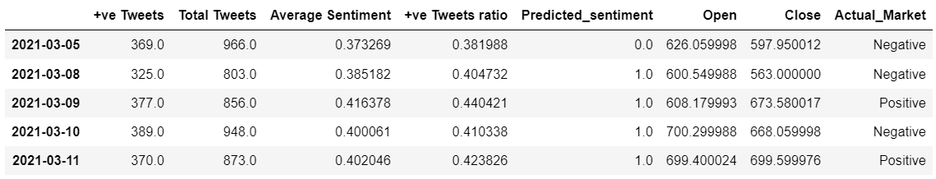
Aggregated sentiment for a day
Stocktwits labelled data
Virgin america data

Slide 15
accuracy
Threshold taken is the average of the sentiment score in each case
If sentiment score > threshold, then 1 else 0
 | Labelled Stocktwits | VA data
Threshold | 0.73 | 0.38
accuracy | 60 % | 54 %

Slide 16
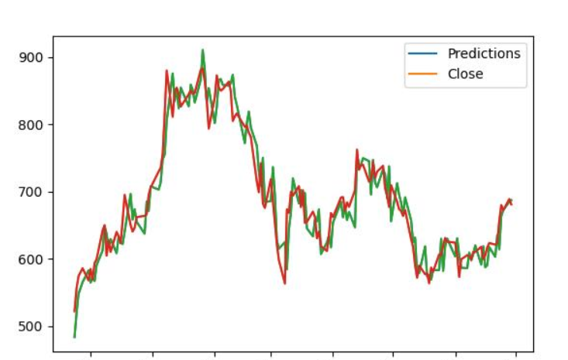
Traditional Prediction Models
Time Series

Slide 17
Learnings
Sentiment score cannot be used as the only criteria for determining the daily stock market predictions however it is a good indicator.
Fundamental factors like EPS or valuation multiples such as P/E ratio drive stock prices based on a company's earnings and profitability from producing and selling goods and services.
Technical factors like inflation, demographics, liquidity, trends etc. relate to a stock's price history in the market pertaining to chart patterns, momentum, and behavioral factors of traders and investors
Sentiment analysis on non polarized data is expected to work better.
Stocktwits bullish & bearish tweets cannot be considered as fully reliable
.

Slide 18
Future recommendations
Sentiment analysis can be complimented with time series model to perform better predictions. For example, a weight should be allotted in the model for the sentiments predicted via tweets data.
Use tweets as a supplement to news data
Expand analysis to stock from different industries
Stock prices are driven by a variety of factors, but ultimately the price at any given moment is due to the supply and demand at that point in time in the market.

Slide 19
Thank you!
Questions?

